Slide 1
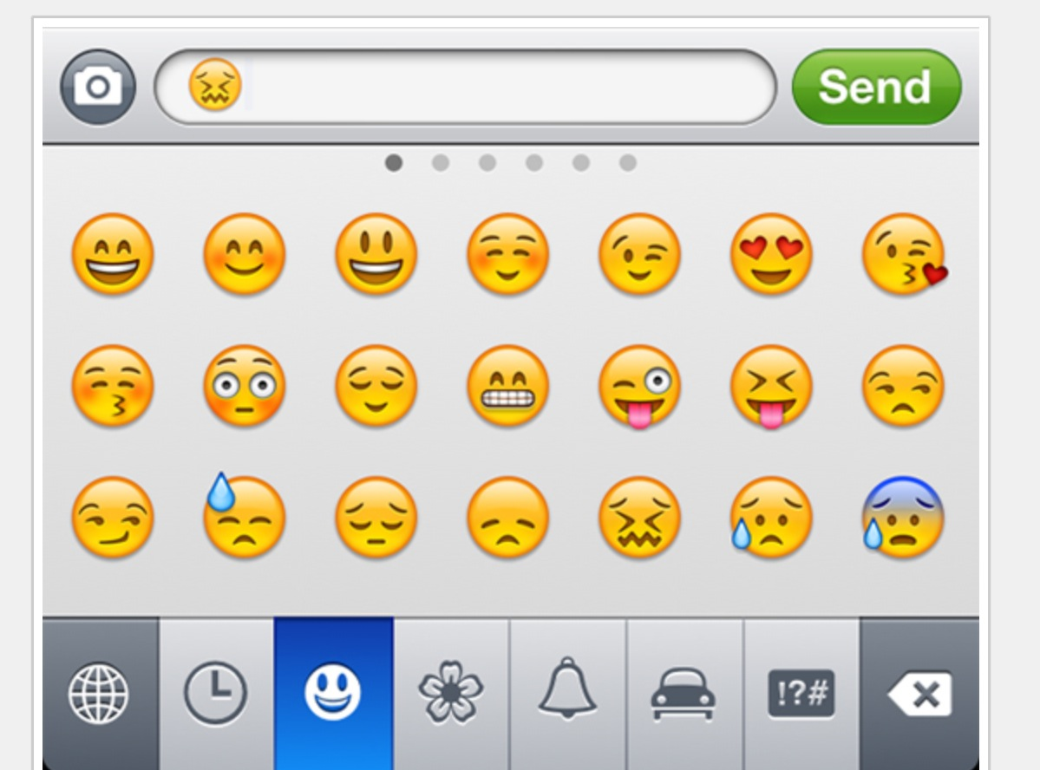
In reality sentiment is more complex.
Many Many Emoji

Slide 2

How should you deal with emojis?
Options to deal with Emoji
Ignore, odd characters will show up, usually low frequency
Remove these unknown characters
Substitute for known text that can be analyzed
Open D_Dealing_W_Emoji.R

Slide 3
Kind of related…
library(politeness)
Identified “markers” of politeness in text
Academic Research, may not be broadly applicable
WARM
TOUGH
Looks in a positive list of 2k terms & ~5k negative term list
Then applies part of speech tagging looking for 36 annotations
Thus the word choice from the list is in context with the order of other POS. If it satisfies being both within the predefined list and a POS annotation it will be identified as warm/tough.

Slide 4
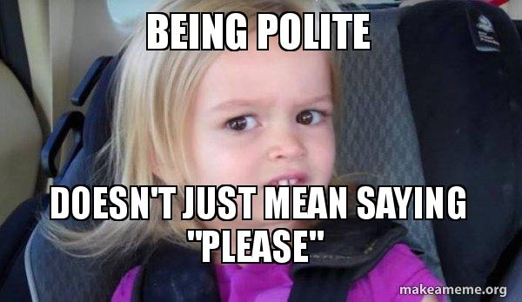
Open E_politeness.R

Slide 5
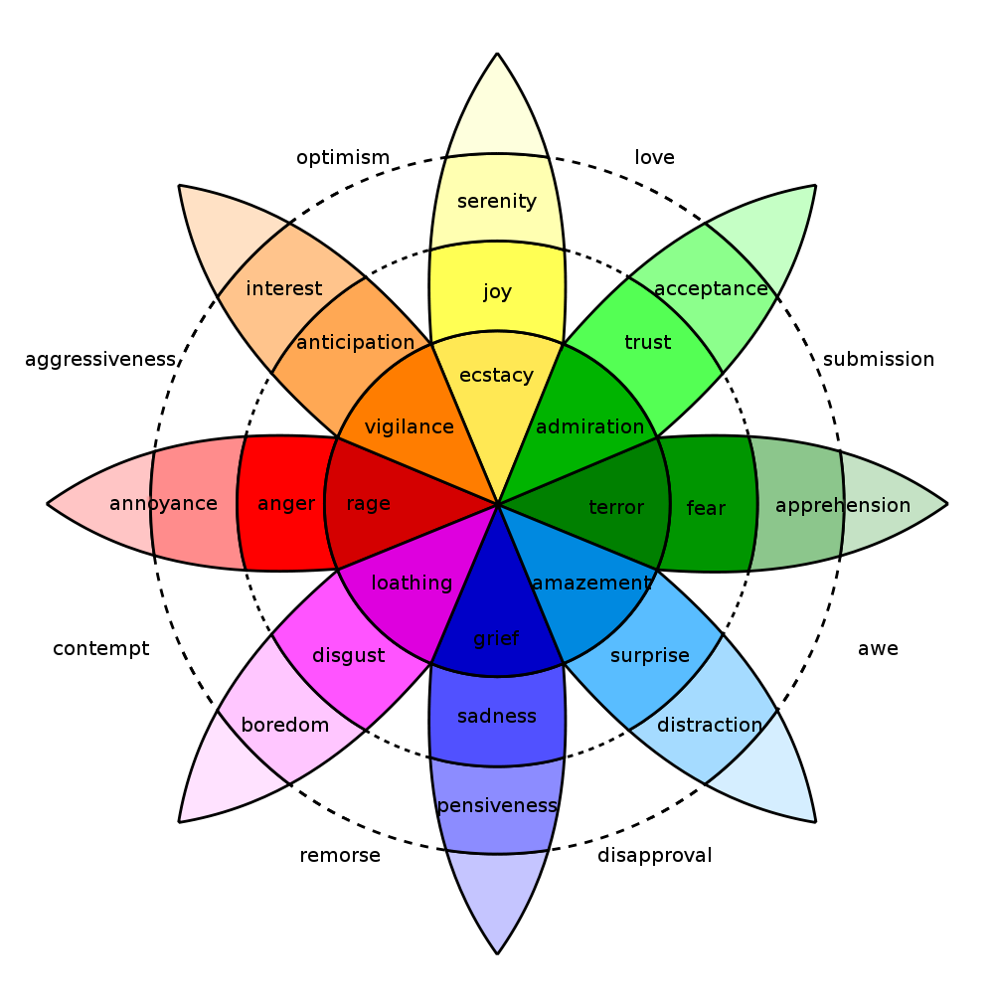
In reality sentiment is more complex.
Many Many Emoji

Slide 6
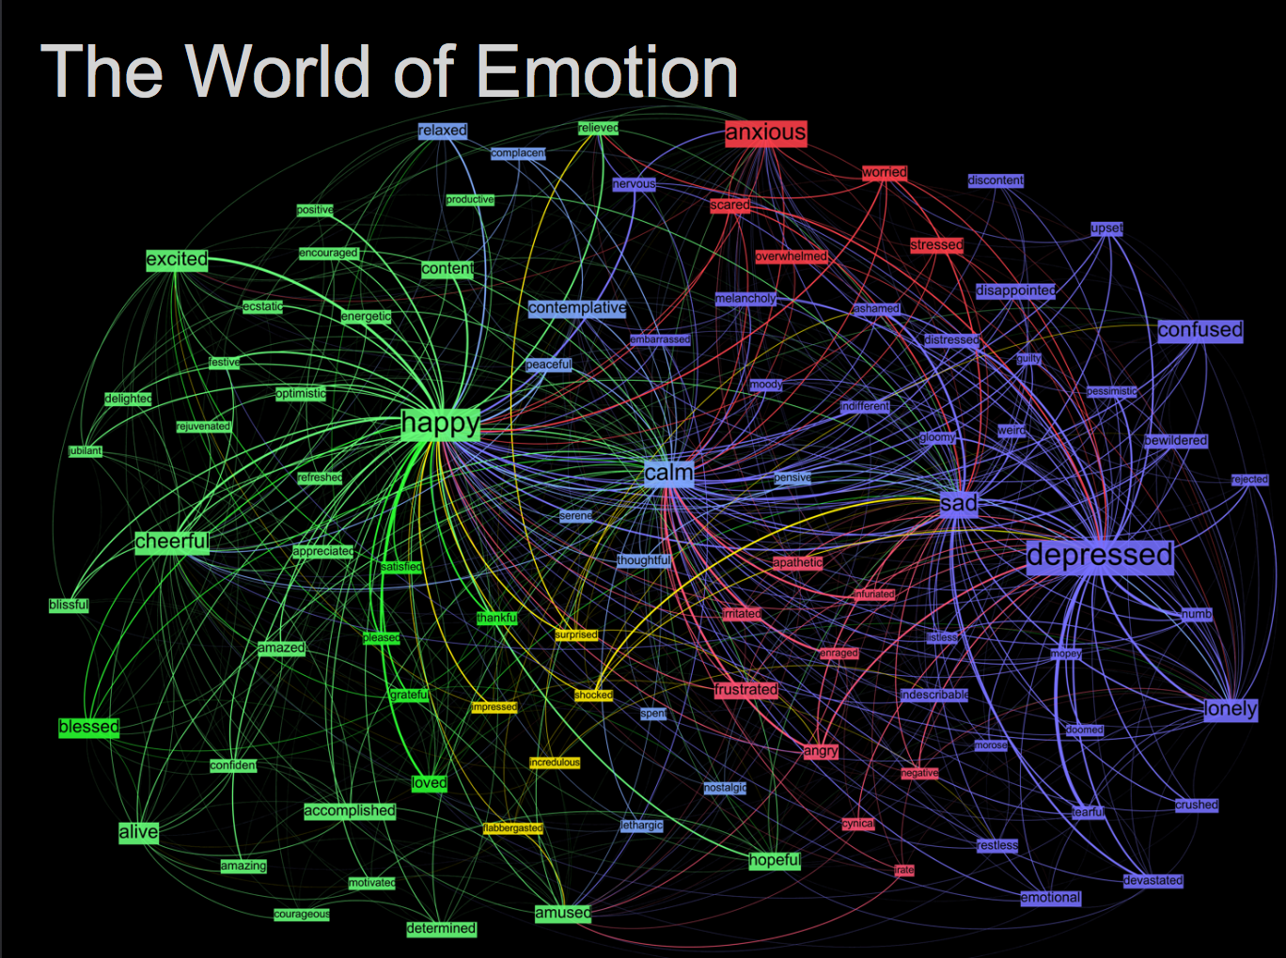
Kanjoya’s Experience Corpus

Slide 7
Tidy Data Formats are structured differently
Tidy Form (Triplet, Dense Data)
Document Term Matrix
Document | Term | count
Tweet1 | Term2 | 1
Twee1 | term3 | 1
Tweet2 | Term2 | 1
Tweet3 | Term… | 3
Tweet… | Term… | 1
Tweet… | Term_n | 1
Tweet_n | Term… | 1
 | Term1 | Term2 | Term3 | … | Term_n
Tweet1 | 0 | 1 | 1 | 0 | 0
Tweet2 | 0 | 1 | 0 | 0 | 0
Tweet3 | 0 | 0 | 0 | 3 | 0
… | 0 | 0 | 0 | 1 | 1
Tweet_n | 0 | 0 | 0 | 1 | 0
Sparse Data: Memory used to hold 0s
Dense Data: Efficient in Memory

Slide 8

The pipe operator…%>%

Slide 9
Tidy data uses %>% to forward objects
In the “tidyverse” code is structured so it is more easily read using the %>%. The data format is a tibble usually not a data frame.
mtcars
mtcars %>% group_by(cyl)
mtcars %>% group_by(cyl) %>% mutate(rank = min_rank(desc(mpg)))
This reads as “Using the mtcars object then group by the cyl vector then mutate a new variable called rank.

Slide 10

In this exercise we will examine 565 News Articles
Not by news channel but overall how can we measure emotional words. You could perform this analysis by news channel looking for biases in subjects but its not the point of our script.

Slide 11
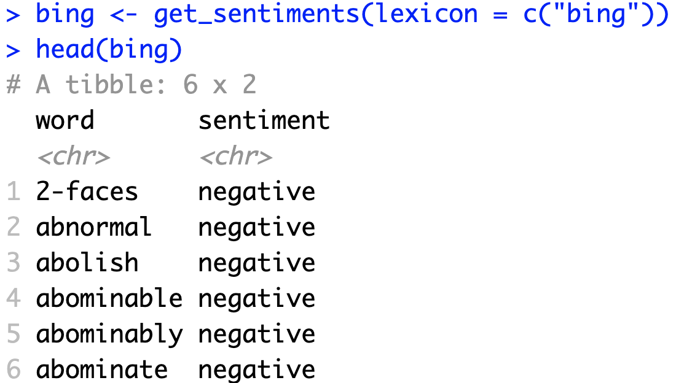
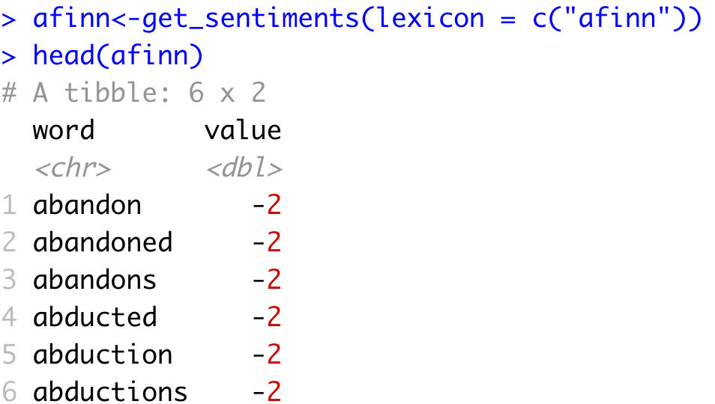
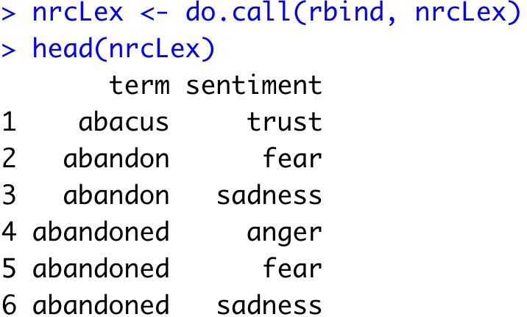
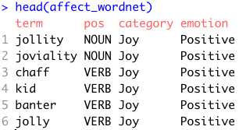
Sentiment the Tidy Way uses joins with existing lexicons
6782 Words
2477 Words
4463 Words
1519 Words

Slide 12
Tidy can seem complicated but not impossible.
The pipe operator
%>%
Forwards an object so the code is easy to understand & concise.
all.tidy <- all.tidy %>%
anti_join(stop_words)
Text
Stop words
We use cleanCorpus instead but this is another type of join example.
anti_join()
all.sentiment <- all.tidy %>%
inner_join(nrc.lexicon) %>%
count(tweet,sentiment) %>%
spread(tweet, n, fill = 0)
Sentiment
words
Text
inner_join()

Slide 13
Starting with a DTM, its straightforward
# DTM
txtDTM <- DocumentTermMatrix(txtCorpus)
# Tidy
tidyCorp <- tidy(txtDTM)
# Get bing lexicon
bing <- get_sentiments(lexicon = c("bing"))
# Perform Inner Join
bingSent<-inner_join(tidyCorp,
bing, by=c('term'='word'))
DTM is from the “tm” library
Easy way to make it into a tibble.
Text to Analyze
Bing Lexicon
* Due to some changes, the first time you use a sentiment lexicon, you will be asked to download. This is due to licensing.

Slide 14

Get in touch with our feelings…
Open G_sentimentAnalysis.R

Slide 15
Let’s recreate Plutchik’s Wheel of Emotions
Back to the script!

